Slide 1
Image
Name | Dharini Baskaran
Identity Key | {Replace this with your identity key}
 | Level | Completed
 | Beginner | 0
 | Intermediate | 0
 | Advanced | 0
 | Expert | 0
Goal
4722 | 10
5722 | 12
Total Completed
0

Slide 2
Image
CSCI 5722/4722: Computer Vision
Spring 2024
Dr. Tom Yeh
Dr. Mehdi Moghari

Slide 3
Common Image Types

Slide 4



Binary Image

Slide 5






Grayscale Image

Slide 6
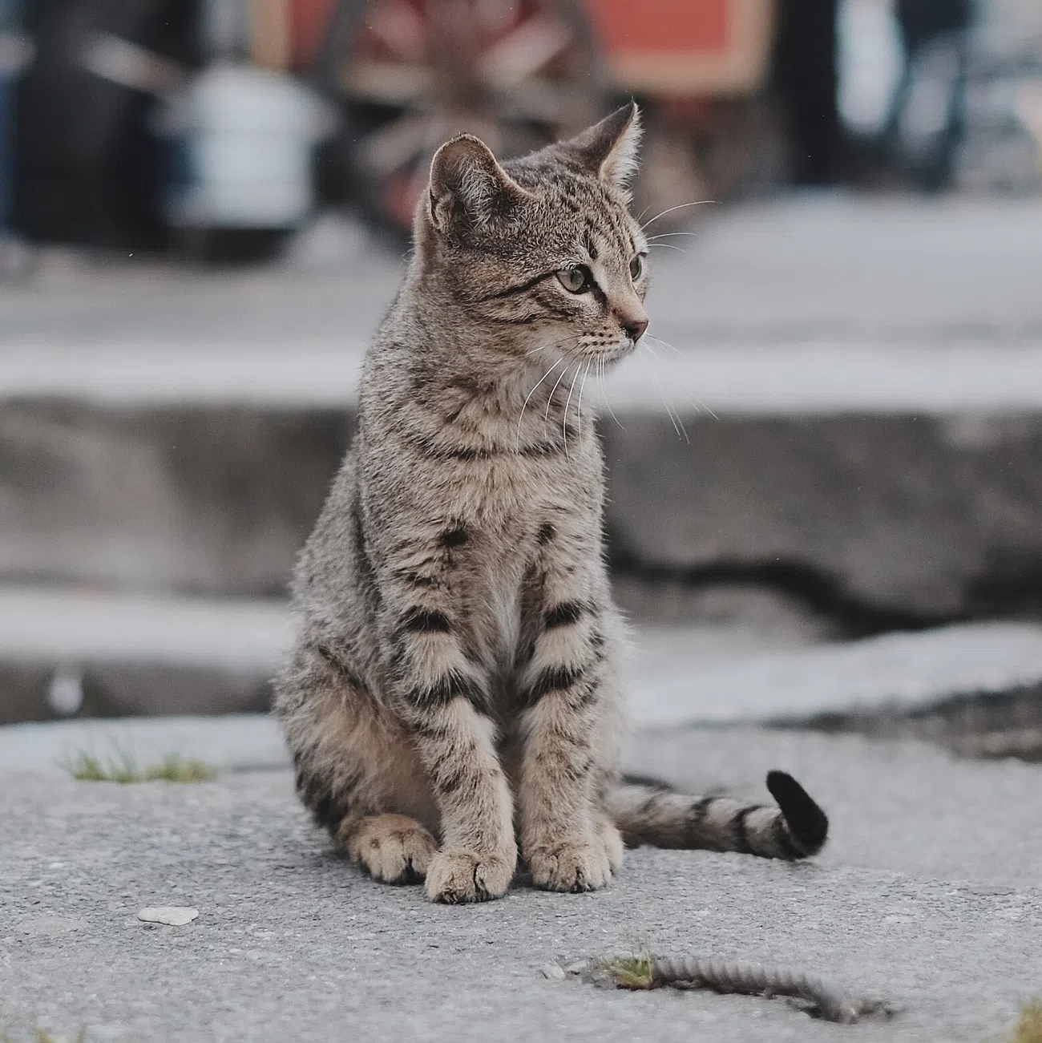

Binary Mask

Slide 7








Color Image

Slide 8
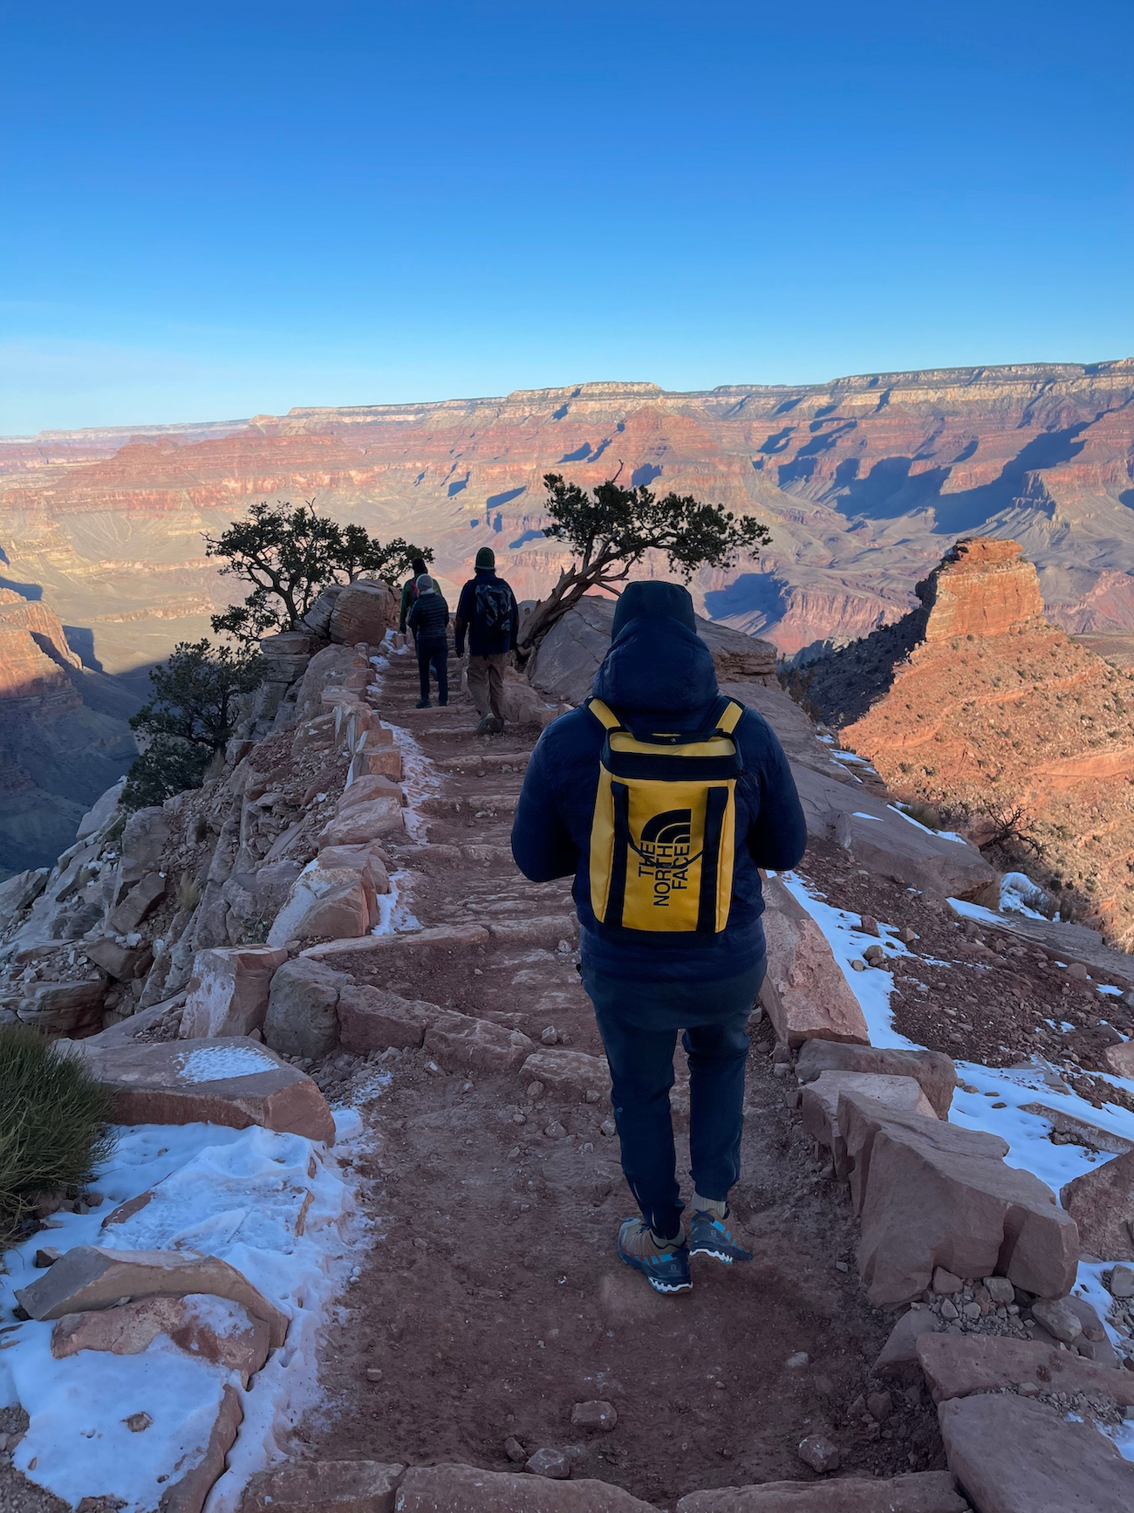
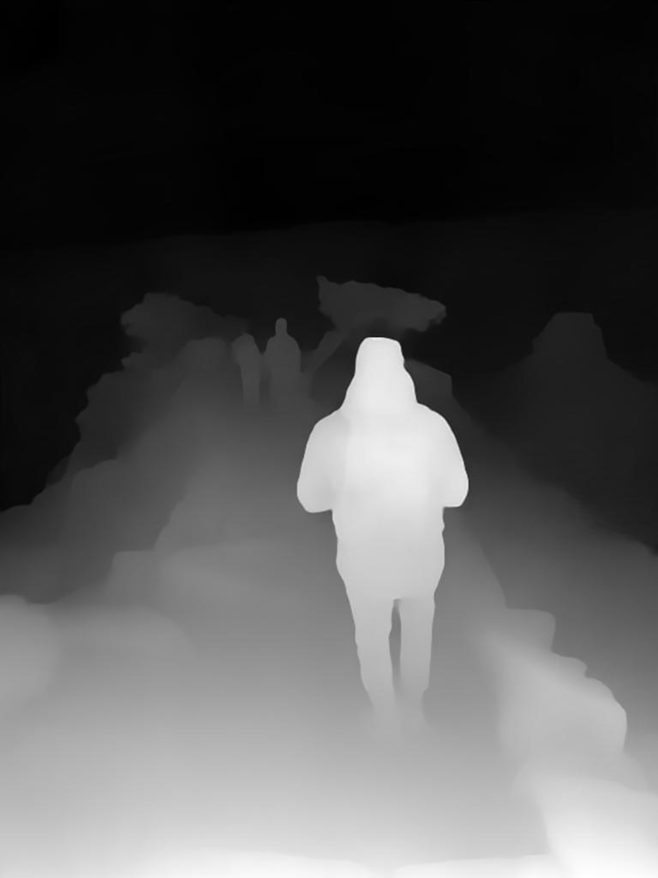
Depth Map
Image Credit: https://lookingglassfactory.com/blog/depth-map

Slide 9
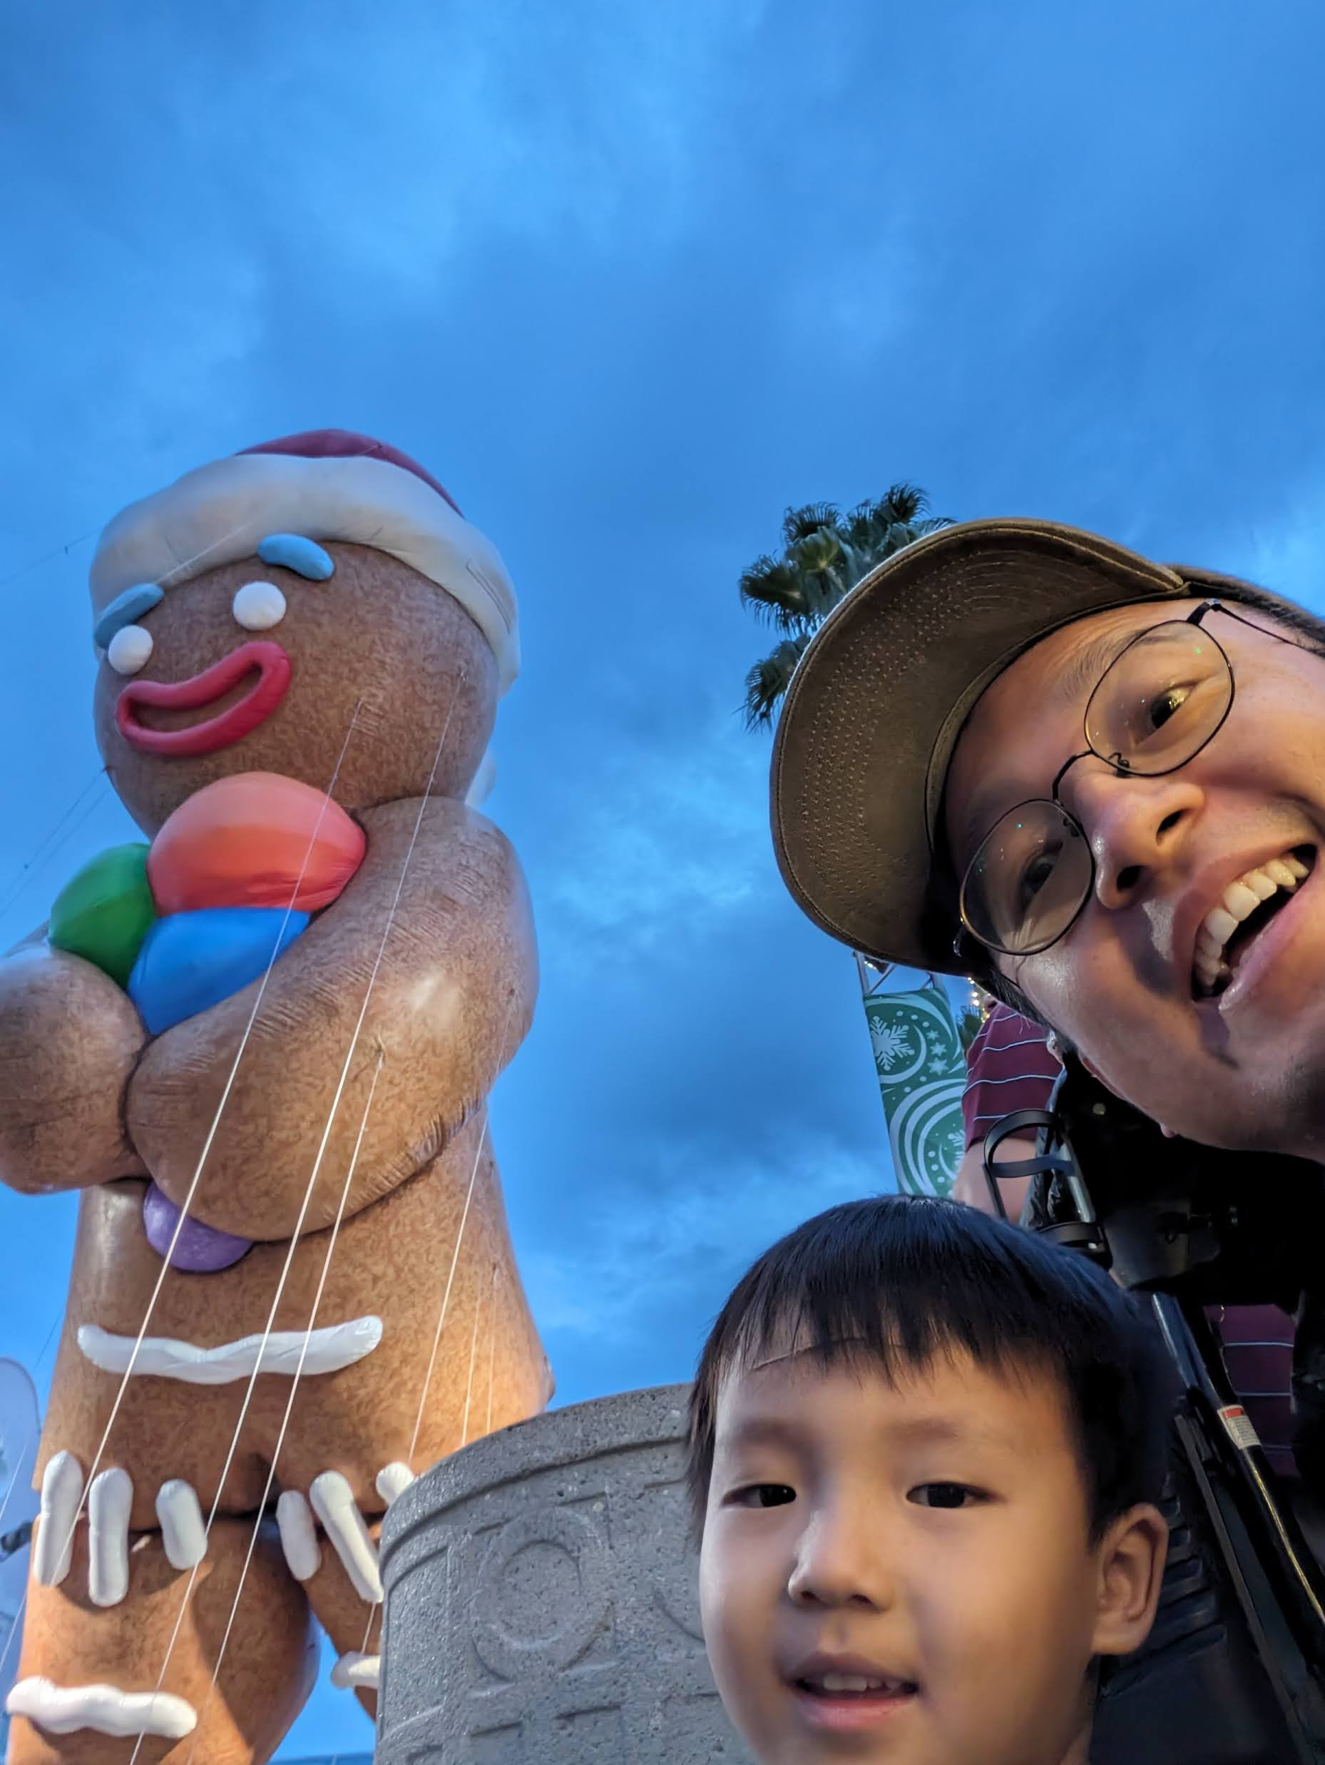
























Depth Map
5: closest, 0: furthest
Template

Slide 10

Depth Map
{replace this with your own holiday photo}
5: closest, 0: furthest
Template

Slide 11
Image Function

Slide 12






Image Function

Slide 13





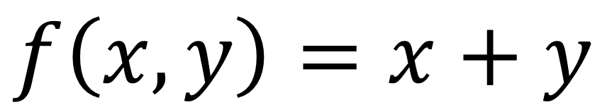










Function to Image
2
1
0
-1
-2
$$f\left(x,y\right)=x+y$$
-2 | -1 | 0 | 1 | 2

Slide 14



Image to Function
2
1
0
-1
-2
 | 1 | 1 | 1
 | 1 | 1 | 1
 | 1 | 1 | 1
$$f\left(x,y\right)=$$
-2 | -1 | 0 | 1 | 2

Slide 15
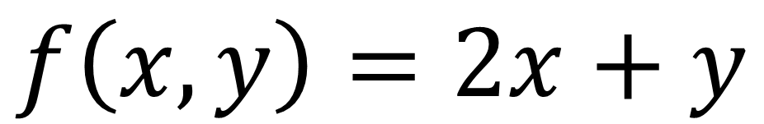
Function to Image
2
1
0
-1
-2
-2 |  |  |  | 6
 |  | 0
-6 |  |  |  | 2
$$f\left(x,y\right)=2x+y$$
-2 | -1 | 0 | 1 | 2

Slide 16


Image to Function
2
1
0
-1
-2
 |  | 1
 | 1 |  | 1
1 |  |  |  | 1
 | 1 |  | 1
 |  | 1
1 if ______________
$$f\left(x,y\right)=$$
0 otherwise
-2 | -1 | 0 | 1 | 2

Slide 17
Image Function Operations

Slide 18

Flip
 |  | 1
 | 1
1 | 1
 | 1
 |  | 1

Slide 19
Negate
 |  | 1
 | 1 | 1 | 1
1 | 1 |  | 1 | 1
 | 1 | 1 | 1
 |  | 1

Slide 20





Add
 | 2 | 2 | 2
 | 2 |  | 2
 | 2 | 2 | 2

Slide 21
Write the image operation in the blank
f(x, y)
________________________
 | 3 | 2 | 1
 | 2
 | 1
4 | 4 | 4 | 4 | 4
4 | 7 | 6 | 5 | 4
4 | 6 | 4 | 4 | 4
4 | 5 | 4 | 4 | 4
4 | 4 | 4 | 4 | 4

Slide 22
Write the image operation in the blank
f(x, y)
________________________
 | 3 | 2 | 1
 | 2
 | 1
 | -3 | -2 | -1
 | -2
 | -1

Slide 23
Write the image operation in the blank
f(x, y)
________________________
 | 3 | 2 | 1
 | 2
 | 1
1 | 1 | 1 | 1 | 1
1 | -2 | -1 | 0 | 1
1 | -1 | 1 | 1 | 1
1 | 0 | 1 | 1 | 1
1 | 1 | 1 | 1 | 1

Slide 24
Write the image operation in the blank
f(x, y)
________________________
 | 3 | 2 | 1
 | 2
 | 1
 | 1
 | 2
 | 3 | 2 | 1

Slide 25
Write the image operation in the blank
f(x, y)
________________________
 | 3 | 2 | 1
 | 2
 | 1
 | 1 | 2 | 3
 |  |  | 2
 |  |  | 1

Slide 26
Write the image operation in the blank
f(x, y)
________________________
 | 3 | 2 | 1
 | 2
 | 1
1 | 1 | 1 | 1 | 1
1 | 0 | 1 | 1 | 1
1 | -1 | 1 | 1 | 1
1 | -2 | -1 | 0 | 1
1 | 1 | 1 | 1 | 1

Slide 27
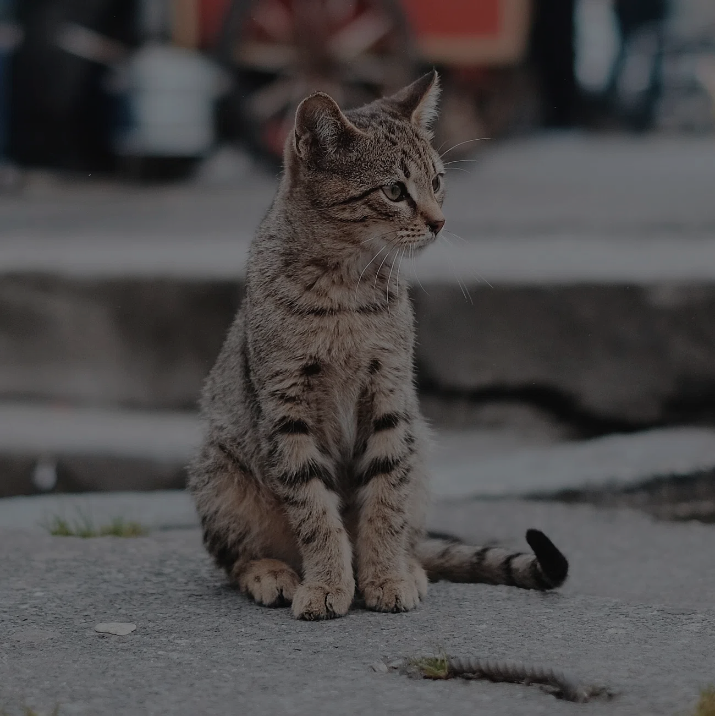
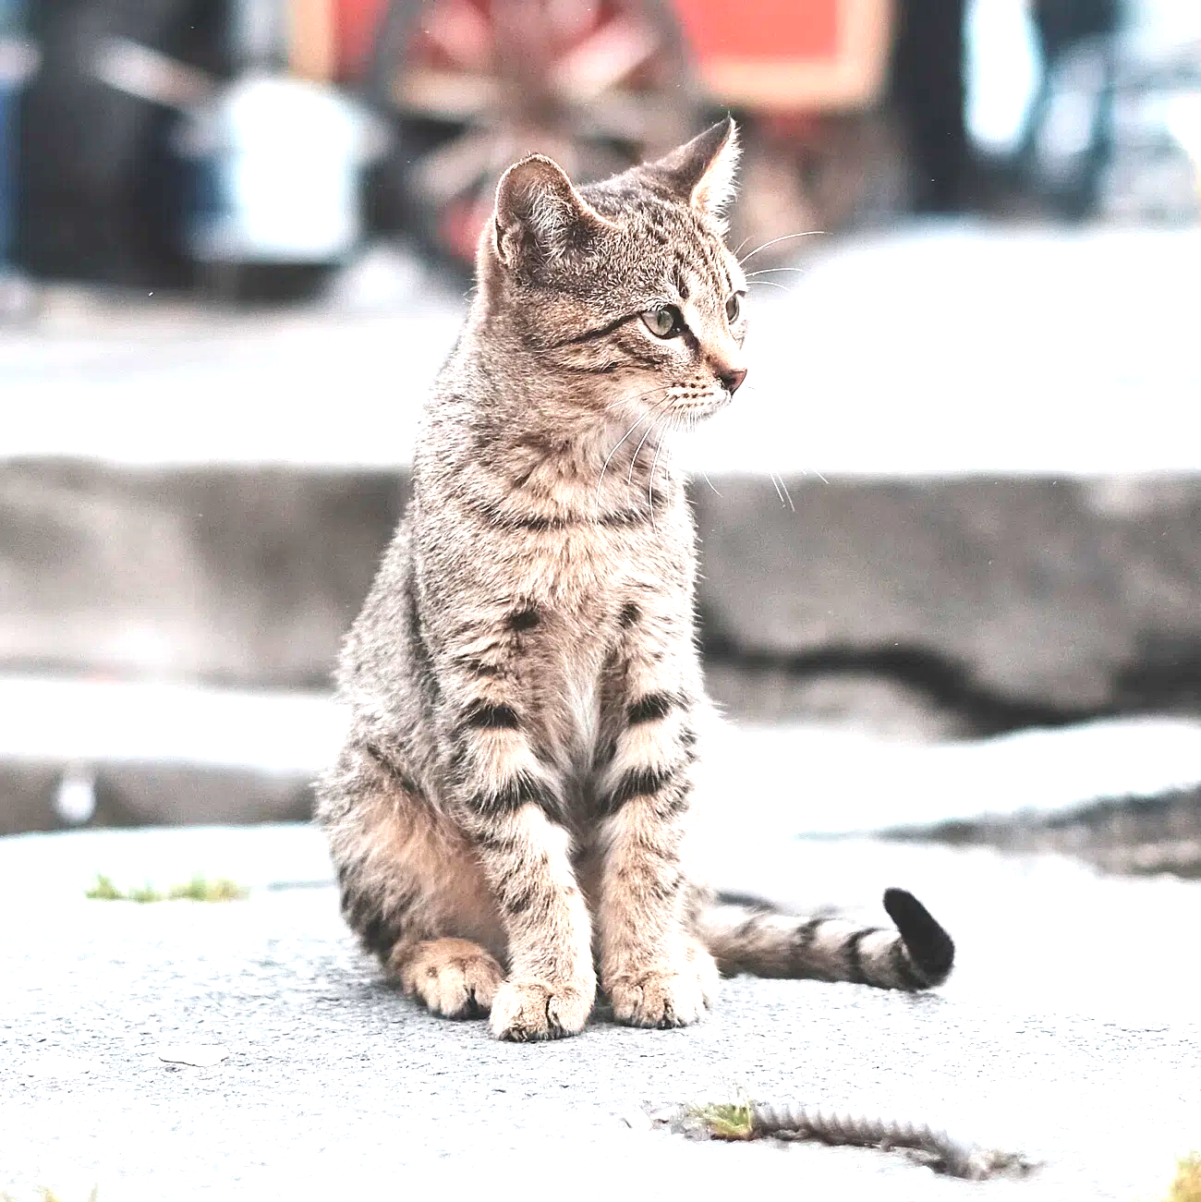



Q: What are the operations for A and B?
f
A=
B=

Slide 28

Q: What are the operations for A and B?
f(x,y)
A=
B=
y
y
y
x
x
x

Slide 29




Add Two Images
1 | 1 | 1 | 1 | 1
 |  | 3
 |  | 3
 |  | 3
 |  | 3
 |  | 3

Slide 30





Masking

Slide 31





Filter

Slide 32
What is the mask m?
f
m
f & m
 | 1 | 1 | 1 | 1 | 1 | 1
 | 1 | 2 | 3 | 3 | 2 | 1
 | 1 | 3 | 5 | 5 | 3 | 1
 | 1 | 3 | 5 | 5 | 3 | 1
 | 1 | 2 | 3 | 3 | 2 | 1
 | 1 | 1 | 1 | 1 | 1 | 1
 |  |  | 3 | 3
 |  | 3 |  |  | 3
 |  | 3 |  |  | 3
 |  | 2 | 3 | 3 | 2
 |  |  | 1 | 1

Slide 33
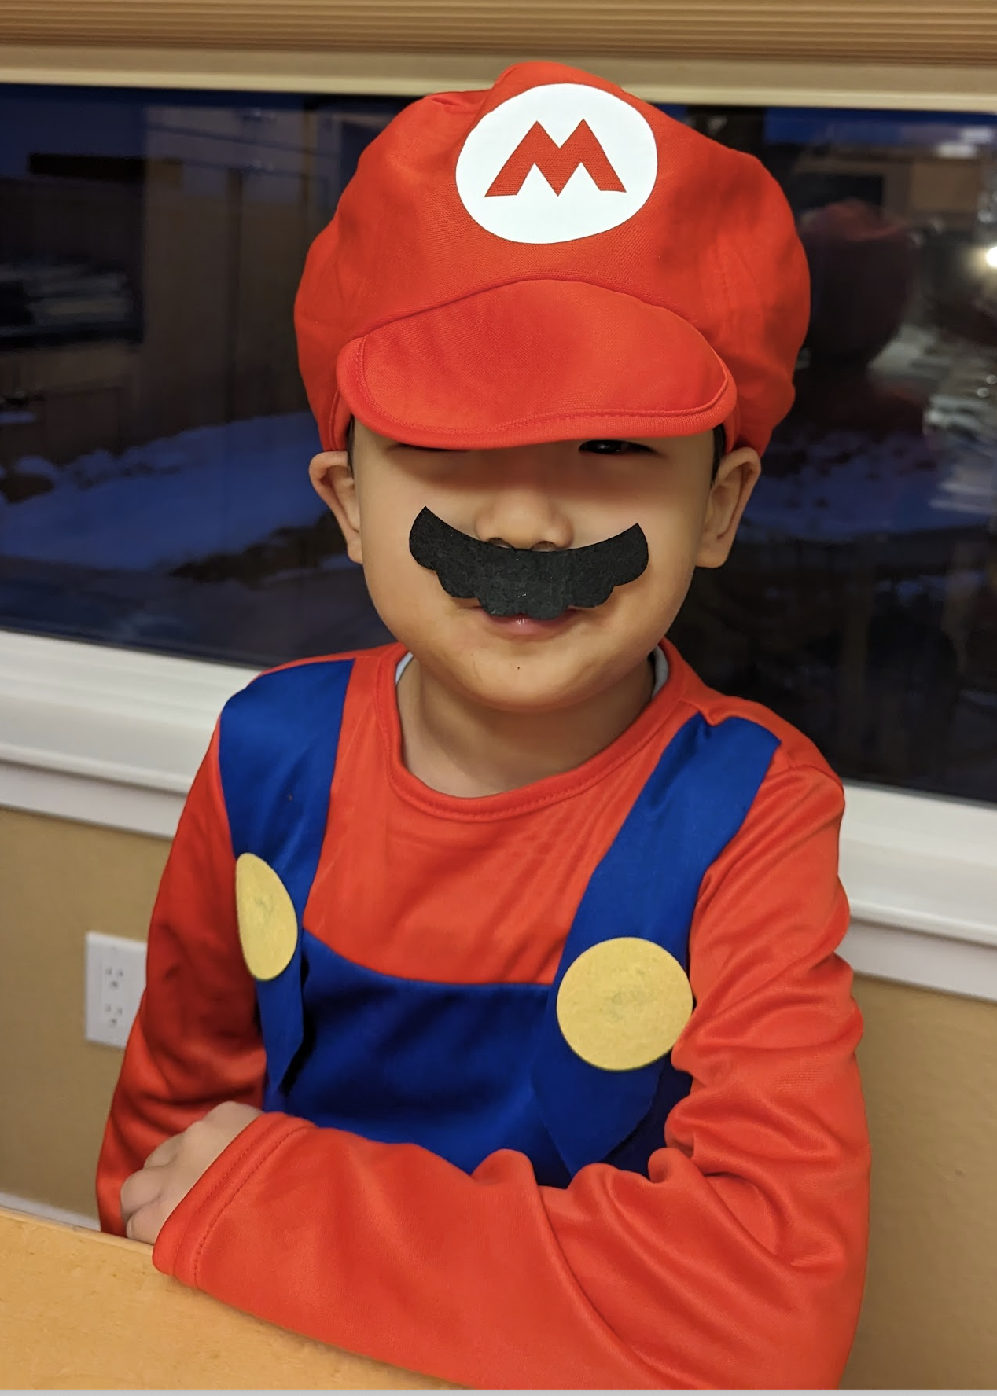
Flip the image (use PowerPoint’s flip)
f(x,y)
f(-x, -y)
f(-x, y)
y
y
y
x
x
x

Slide 34
Resize the image (use PowerPoint’s resize)
f(x,y)
f(2x, y)
f(x/2, 2y)
y
y
y
x
x
x

